Slide 1
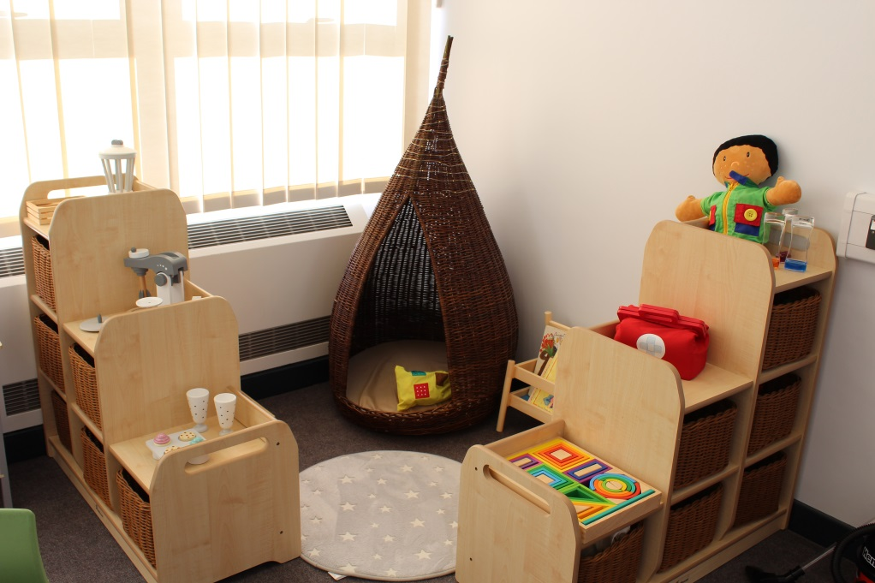
Norfolk ASD Specialist resource bases
A bit more info …

Slide 2
Where are we based…
Locations:
EYFS & Key stage 1
Sprowston Infant School
Key stage 2
Bluebell Primary School
Cromer Junior School
Edward Worlledge Ormiston Academy
Key stage 1 and 2
Millfield Primary School
Nelson Academy
Redcastle Family School
Drake Primary
Key stage 3 and 4
Cromer Academy
Dereham Neatherd High School
The Hewett Academy
Open Academy
Thetford Academy

Slide 3
What we offer…
Services:
A qualified teacher is in charge of the base and all staff are trained and experienced in working with children / young people with autism
Each child / young person will have an individualised support package
All children / young people will have a full-time timetable in line with the main school day
Children / young people will be included in mainstream school lessons and events, suitable to the needs of the individual
A space which is just for members of the base
Resources and equipment
Close liaison between home and school
Support throughout the school day as needed
Access to specialist support professionals including Educational Psychologists
Supervision during breaks and lunchtimes
Parents and carers are closely involved in planning and reviewing their children’s learning

Slide 4
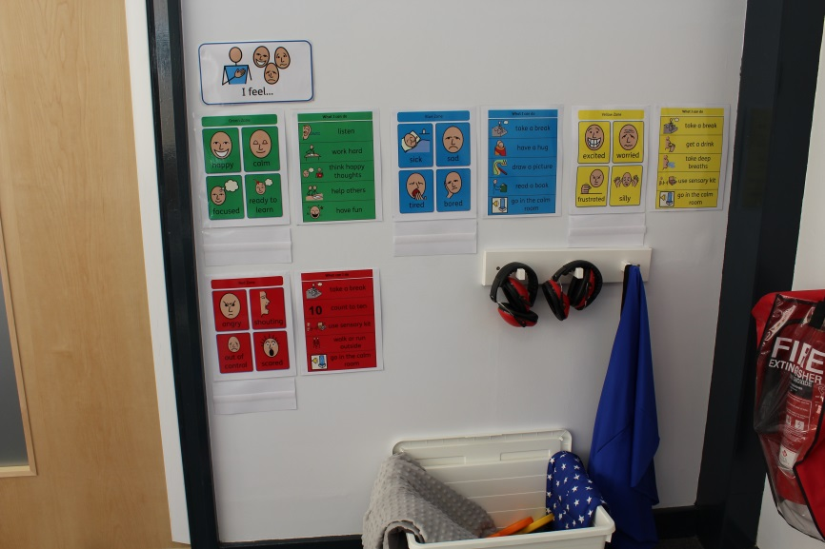
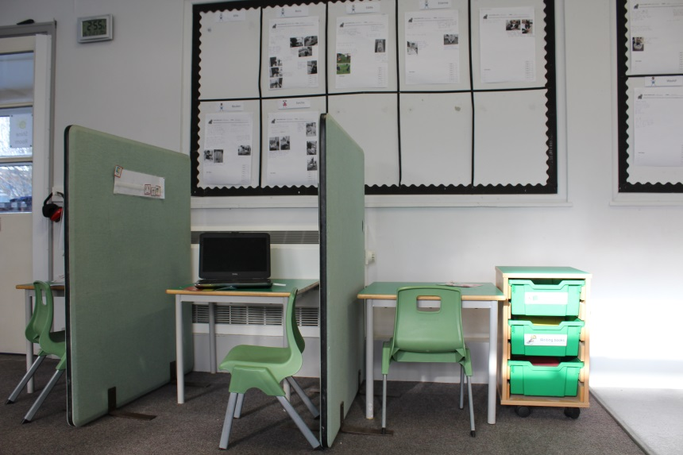
Sprowston SRB

Slide 5
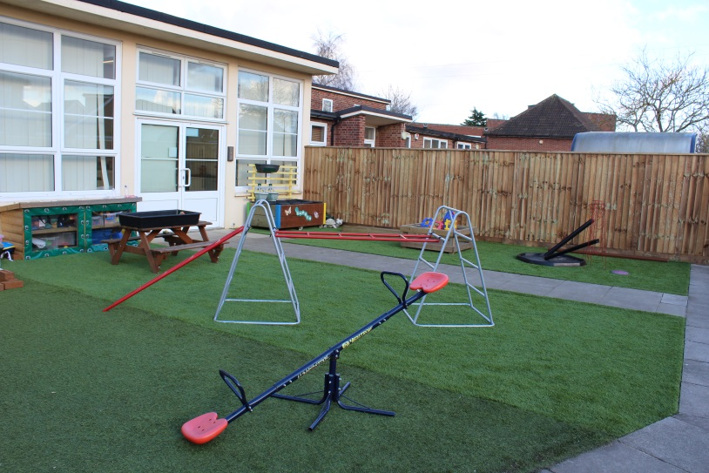
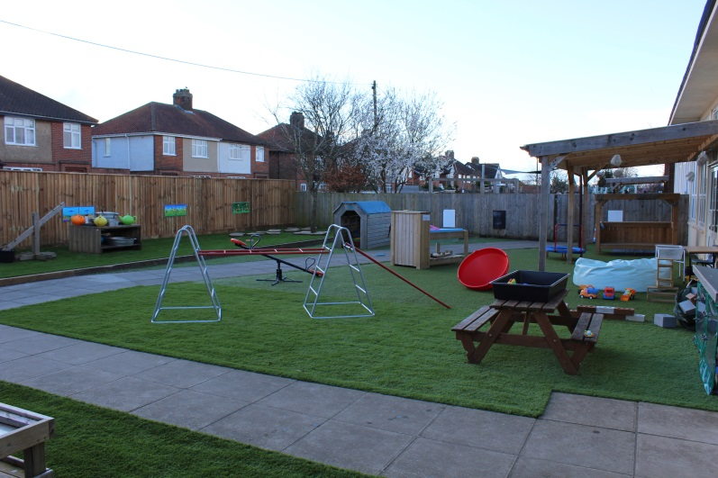
Sprowston SRB

Slide 6
The needs of the child…
It would be expected that school-based interventions have not been effective in enabling the learners to make progress in line with their assessed ability. Learners who access provision through the SRB would typically fit the following profile:
Must be in the age range appropriate to the school unless individual agreement has been negotiated with the commissioner
Have a primary diagnosis of ASD, although related diagnoses could also be considered. Irrespective of the terminology of the diagnosis the learner will exhibit significant difficulties in the triad of Communication, Socialisation and Flexibility of thinking which hinder or prevent them from engaging in mainstream education
Likely to hold an Education Health and Care plan but this is not necessary for placement
Live within 45 minutes (60 minutes for secondary phase) travel time by car to the SRB
Have a range of secondary needs such as speech language and communication, specific learning difficulty, behaviour, emotional, social, physical, medical, sensory needs

Slide 7
May have emerging or unmet social, emotional and/or mental health needs in addition to ASD
Have the underlying cognitive ability to access a mainstream school curriculum once barriers to learning have been addressed
Would not meet the criteria for complex needs school (except for Sprowston Infants SRB which operates a diverse profile of learners ie complex needs and/or SRB)
High levels of anxiety related to confusion and/ or fear of what is happening in the immediate environment such that the ability to learn is severely compromised
Extreme difficulties in the understanding and acceptance of age-appropriate social rules governing, for example, turn-taking, collaborative activities and the sharing of adult attention
Lack of awareness, to a greater or lesser extent, or even apparent disregard of personal safety and that of others.
A strong and obtrusive adherence to routines and rituals which makes any change of routine very challenging and may even provoke defiance or other negative reactions
Considerable, persistent and pervasive problems in establishing and sustaining relationships with peers
Ego-centric behaviour that fails to take into account consideration for others in relation to what would be viewed as age-appropriate behaviour in any particular situation
The absence of other primary reasons or causes for these difficulties

Slide 8
How to make a referral
Referrals can only be made from either the home school and/or the EHC Plan Co-ordinator.
Parents and carers must be involved in discussions about SRB placements and agree to any referral and subsequent placement at an ASD base.
A placement at an ASD base means the child moves on to the roll of the school
If the child has an Education Health and Care Plan Co-ordinator the school should discuss this with them
During the pre-referral stage parents need to visit the SRB they are considering. This must be at a pre-arranged time.
Referrals and admissions to ASD bases are managed by a county wide admission process including half termly admission meetings
School must contact the SRB, once the referral is submitted, to arrange for the SRB to visit the child prior to the admissions panel

Slide 9
Any Questions?
?

