Slide 1
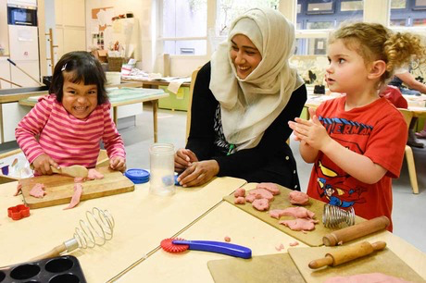
Supporting young children with English as an Additional Language
Sejal Payne
Independent Education Consultant
©️ copyright of Sejal Payne Education 2021

Slide 2
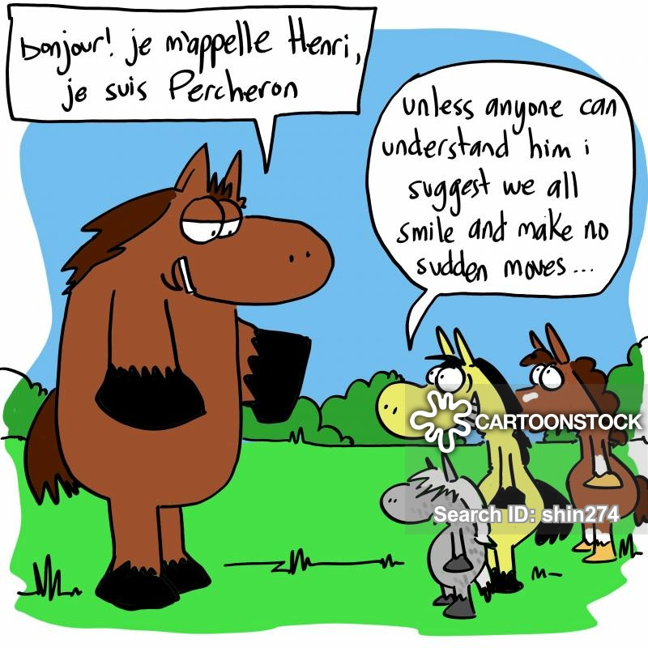
Who are our children with EAL?
How do you define them?
What are the key issues?

Slide 3
Who are our children with EAL ?
‘Young children within the broad development span of 0-5yrs may be anywhere along the language development continuum in one or more languages. Some will be beginners in one language, but proficient in another; others will be on varying stages of fluency in one or more languages. The term EAL also recognises that many children learning English in settings are already developing more than home language and adding English to their repertoire.’
PNS Guidance for EYFS, Supporting children learning EAL, 2007

Slide 4
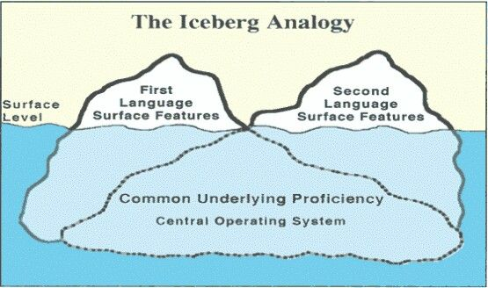
Distinctiveness of EAL

Slide 5
Settling in…..
How prepared are you for the children with EAL?
Getting to really know our children and families
Detailed Information gathering
Setting positive and trustful relationship at the onset
Value what the children and families bring into the setting
Identify key barriers ( child, family and setting)
Role of the key worker
Early intervention

Slide 6
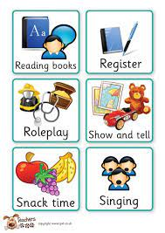
Early stages of acquiring English
Allow for ‘silent period’
Prioritise the language to teach (survival, social, academic )
Build on prior knowledge – use of first language to develop English language acquisition in context
Plan for opportunities in small groups for target language for hearing and rehearse new vocabulary language - pre
Pre-teach concepts and language –to introduce and model new language and comprehension.
Visual support to provide context, scaffold and the ‘hanging pegs”
Practical activities with a language focus
Parental involvement

Slide 7
The importance of EAL Assessment
Identify gaps in learning as well as English language
Through observational assessment as well as EAL assessment
Distinguish between English language acquisition as well as development of knowledge and concepts across the areas of learning in EYFS

Slide 8
Importance of home language
Children develop identity and cultural knowledge
Children develop social skills and emotional intelligence
Children develop self esteem
Children develop crucial thinking and language skills
Children develop English and learning
Parental involvement improves outcomes

Slide 9
Keep the home language alive!
Bilingual signs and welcome walls, displays
Read books together in either language and talk about the pictures and ideas
Make bilingual books of new words
Celebrate the language – make sure the child is proud to be a speaker of two or more languages
Involve the parents

Slide 10
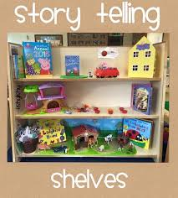
Speaking and listening focus
Book related talk
Story sacks /puppets role play
Songs , rhymes, poems and games
Bilingual stories ,rhymes & songs
Vocabulary and grammar building activities
Barrier games /language games
Lots of practical activities supported by talk
https://worldstories.org.uk

Slide 11
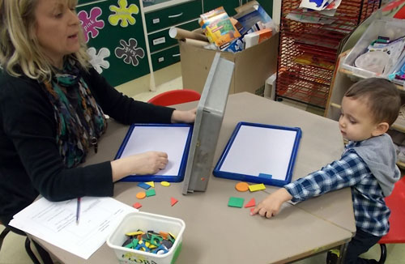
Barrier Games
Introduces and model new Vocabulary building
Language building – extend sentence structure
Giving and receiving instructions
Describing
Grammar – preposition, past tense
Maths – shape, colours, position, direction, space
Develop speaking & Listening behaviours
Raises confidence in Oracy
Increases questioning skills
http://talkingmatters.com.au

Slide 12
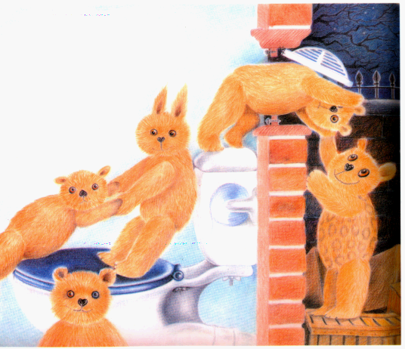
Talk! Talk! Talk! Talk!
Using books to support talk
Talk about the pictures
Talk about the story
Talk about the vocabulary – meaning
Talk about own experiences

Slide 13
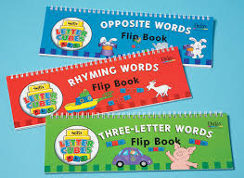
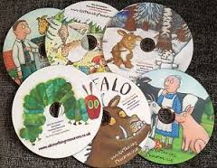
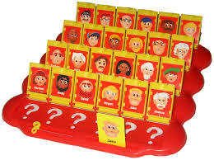
To embed – children need to “hear it” and “say it” again and again and again…
Why are these good resources for developing vocabulary?

Slide 14
Supporting the parents
How do you connect with your parents.
/carers ?
Building relationships early ?
How do you identify needs? what is in place to address need?
How do you maintain trustful and effective relationships?

Slide 15
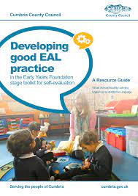
Review and action planning
https://www.cumbria.gov.uk/elibrary/content/internet/537/955/6075/6263/6314/4202792235.pdf

Slide 16
Websites
https://www.michaelrosen.co.uk/poems-and-stories-about-my-family/
https://www.newburyparkschool.net/lotm/activitiesbooklet.pdf
ealhighland.org.uk/resources/teddy-talk-narrative-based-language-development-programme-eal-children-nursery-school/
http://www.mantralingua.com
http://www.collaborativelearning.org

Slide 17
Contact me
Email: info@sejalpayneeducation.com
Mobile: 07826556111
Website: www.sejalpayneeducation.com
Don’t forget to like me / follow me on
@sejalpayneeducation
@sstrainingpartners
@PayneSejal
@SSTrainingpart1
@sejalpayne

