Slide 1
Communication Champions Network Meeting: Limitless language; limitless learning.
Ms Cathy Mann
Learning and Cognition SRB Outreach Teacher for Norfolk
Based at Mile Cross Primary School

Slide 2
“Our vision is to create a system where no child in Norwich is left behind.”
Dr Tim Coulson
Independent Chair of Norwich Opportunity Area Partnership Board

Slide 3
Ms Cathy Mann
Learning and Cognition SRB Outreach Teacher for Norfolk
Based at Mile Cross Primary

Slide 4
Star words
choice understanding
meaning vocabulary
semantics voice
express comprehension

Slide 5
The functions of language:
Emotional expression
Social interaction
The Power of Sound
The Control of Reality
Recording the Facts
The Instrument of Thought
The expression of identity
(Crystal, 1997, p10-13)

Slide 6
Case Study One: Child A
Positive relationships
Enabling environments
Unique Child

Slide 7
Child A: The starting point

Slide 8
Two-years old
Desperate to communicate
Very frustrated
Issues with speech production
Very little spoken language
Desperate to play with peers
Joy when able to interact
Obsessed with dinosaurs
Older sister – good relationship
Very supportive mother with nursery experience
Very physically able
Risky and agile climber
Sometimes experienced sensory overload and became overwhelmed
Tired very quickly
Individual Education Plan put in place – regularly reviewed and updated
Case Study One: Child A
Positive relationships
Enabling environments
Unique Child

Slide 9
Access to outdoor play
Access to quiet areas to play
Change of toddler group to one with more space and soft play area
Key chain with symbols to support expressive language
Communication book to support relationship building
Use of photos, signs and symbols to support communication
Dinosaur bag – for reassurance and for opportunities to talk
Safe places to rehearse language
Case Study One: Child A
Positive relationships
Enabling environments
Unique Child

Slide 10
Partnership with parent
Co-ordination of support with health visitor and sharing of health check at two-years-old
Team-work and joint observations and planning
Building relationship with the child
Taking risks
Meeting the needs of the child
Careful observations that were shared
Scaffolding interactions with peers
Providing opportunities to communicate
Child accessed speech and language unit on entry to primary school
Child is able to interact with his new peers and made himself heard and understood
Case Study One: Child A
Positive relationships
Enabling environments
Unique Child

Slide 11
Case Study One: Child B
Positive relationships
Enabling environments
Unique Child

Slide 12
Child B: The starting point

Slide 13
Three-years old
Seemed unaware of peers – although some disputes where he lashed out
Very limited eye-contact
Following own agenda
Very little spoken language
Repetitive patterns of behaviour
Case Study One: Child B
Positive relationships
Enabling environments
Unique Child

Slide 14
Use of appropriate and carefully selected resources to support exploration of flap schema
Use of local park and swings to practise language of cause and effect i.e. ‘ready steady go’
Made use of separate rooms so had quieter places to play when needed
Use of visual timetable
Use of objects to support making choices by eye-pointing (this later developed into PECS)
Opportunities to mix with peers and opportunities for solitary play
Case Study One: Child A
Positive relationships
Enabling environments
Unique Child

Slide 15
Partnership with parent
Meeting the needs of the child
Careful observations that were shared between team members – led to the identification of a schema
Providing opportunities to explore the schema led to constructive play, a much happier, more settled child and the beginnings of meaningful communication
Specialist advice sought and closely followed
Specialist intervention
Child correctly diagnosed with ASC
Child accessed specialist nursery provision, and specialist school provision on entry
Case Study One: Child B
Positive relationships
Enabling environments
Unique Child

Slide 16
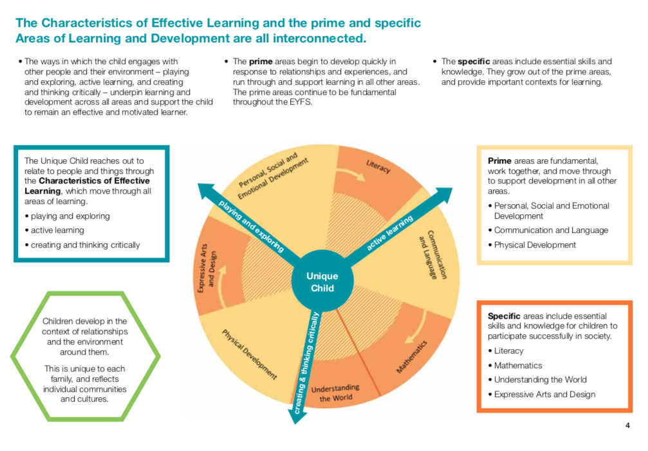
“Good practice remains good practice.”
Yvonne Au, Enabling Children
2012
Development Matters (DfES, 2012 p4)

Slide 17
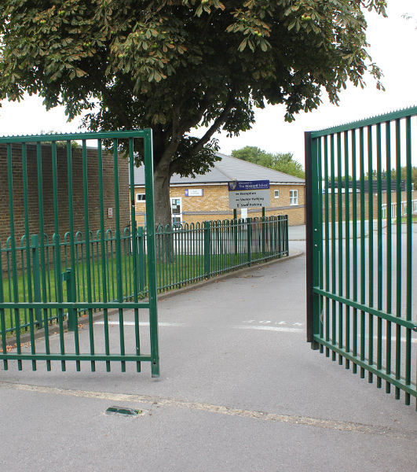
Communication:
A gateway to learning
.

Slide 18
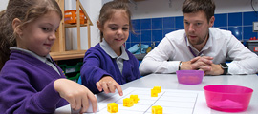
Language is the vehicle by which children communicate their needs and ideas, develop and maintain relationships, and solidify their understanding of essential concepts
(Law et al, 2017, p.12).

Slide 19
1-2% Severe SLCN
7% Developmental Language Disorder (DLD)
10% of all children have SLCN
50% + in some areas starting school
(Cross 2011)

Slide 20
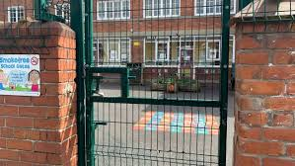
In 2016, only 12% of pupils with SLCN as their primary need achieved at least expected levels in reading, writing and maths by the end of year 1, compared to 53% of all pupils.

Slide 21
What beautiful looks like…
Teacher Liz Curry and speech therapist Jenny Barrett at Carden Primary School's Speech and Language Centre demonstrate the key strategies used at the centre to enable children with severe speech and language difficulties to successfully return to mainstream schooling.

Slide 22
What will you do to open the gate?
What will you do to help them walk through it?.

Slide 23
Credit:
Thanks to the leadership, staff and children at Mile Cross Primary
Thanks to Eileen Macheachern for her recent research
Thanks to Tanya Foreman, Kidz Korner owner
Thanks to Yvonne Au, Enabling Children for her training on Inclusion for All Children and School Readiness
Thanks to Liz Curry for her training on Makaton and help with supporting children with Speech, Language and Communication Needs

Slide 24
References
Cain, K, 2010, Chapter 10: The Simple View of Reading. In: Reading Development and Difficulties: An Introduction. London: John Wiley & Sons. pp.214-222
Crystal, D., 1997. The Cambridge Encyclopedia Of the English Language. 2nd ed. Cambridge: Cambridge University Press.
Drury, R in Hall, K, Goswami, U, Harrison, C, Ellis, S, and Soler, J (Eds), 2010, 'Chapter 4 Young bilingual learners: A socio-cultural perspective' in Interdisciplinary perspectives on learning to read: culture, cognition and pedagogy. London: Routledge.
Eysenck, Michael. & Keane, M. (2015). Cognitive Psychology: A Student’s Handbook. (7th edition). Hove
Cross, M. (2011) Children with Severe SLCN. I CAN Talk Series - Issue 9. London: I CAN.
Hart, B., & Risley, T. (1995). Meaningful differences in the everyday experience of young American children. Baltimore: Brookes Publishing.
Law, J., Charlton, J., Asmussen, K. (2017) Language as a Child Wellbeing Indicator. London: Early Intervention Foundation
The Communication Trust. (2012). Communicating Phonics. London
https://online.clickview.com.au/exchange/videos/33090972/speech-and-language-strategies (Accessed: 11.3.21)

