Slide 1
Talking Mats
Reluctant Talkers, and involving children in decision making.
Emma Ferris, March 2022
Highly Specialist SLT
Associate Professor

Slide 2
Aims & Objectives
After this workshop, and an exploration of the ideas in your own time, you will be able to:
Understand the classification of Reluctant vs. Selective Mutism
Have a theoretical understanding of Talking Mats™
Have a therapeutic tool to begin building seeking child voice in a meaningful way

Slide 3
Diagnostic Criteria

Slide 4
Introduction
Used to be called ‘elective’ mutism(!) but it is an anxiety disorder
Severe & Long-lasting
Interferes with school/work/relationships
Affects between 2 – 18 children per 10,000
Onset is generally between 2-4yrs
Children can talk comfortably in some situations but are persistently silent in others. ‘Speaking habits’ vary from child to child
Children may be able to join in non-verbal activities easily
Often described as 2 different personalities by parents
Previously not seen within the SLT role in the UK until 2006. Crossover with other professionals such as Educational Psychology

Slide 5
‘Pure’ Selective Mutism
Does not talk in certain situations, or under specific conditions, and this is a consistent pattern
There are no indicators that the lack of verbal communication can be wholly explained by an SLCN
They might have some SLCN but in spite of this, converse comfortably with some people and not with others
The are no indicators for significant behavioural, developmental or psychotic difficulties

Slide 6
SM Diagnostic Criteria
ICD-10 | DSM-IV
Marked, emotionally determined selectivity in speaking | Duration is at least one month (not limited to the first month in school)
Language competence in some situations but fails to speak in other definable situations | Consistent failure to speak in specific social situations at which there is an expectation for speaking, despite speaking in other situations
Associated with marked personality features: social anxiety, withdrawal, sensitivity or resistance | Disturbance interfered with educational or occupational achievement or social communication
Excludes: Pervasive developmental disorders schizophrenia other SLCN transient mutism as part of separation anxiety | Excludes: pervasive developmental disorder psychotic disorders Other SLCN lack of knowledge of the language being requested

Slide 7
Reluctant Talker
An anxiety presentation
Has occurred for a short period of time (less than 2 months?) – length of time for diagnosis varies in literature
Is still within the boundaries of functional and social acceptance
Inconsistent speaking habits
Has other diagnoses which rule out pure SM
Only a few elements of SM

Slide 8
Shy vs. Reluctant
Most would think of this as not engaging in the activity or interaction. We may often just call this ‘shy’ but there is more to this…
You might look for 3-4 of the following behaviours:
produces little or no voluntary speech
follows directions but doesn’t verbally respond to them
turns away when spoken to
watch but don’t join other children in fun activities
make little or no eye contact
speak softly
volunteer last and line up last for activities
Do any of these characteristics have other explanations?

Slide 9
Causation

Slide 10
Causation
The Selectively Mute Child
PREDISPOSING FACTORS
- SLCN
- Personality type
- Family history of anxiety
- Family history of psychiatric illness
- Poor function of certain neurotransmitters
- Gender
- A wider anxiety disorder (in conflict with DSM)
PRECIPITATING FACTORS
- Self Awareness
- Teasing
- Separation or loss trauma
- Life event eg. Starting school
PERPETUATING FACTORS
- Reinforcement of mutism
- Over-acceptance of mutism
- Ability to convey message NV
- Social isolation
- Minority group
- Negative models of communication in the family

Slide 11
The effects of SLCN
A child’s confidence in communicating and interacting could be effected due to a difficulty in any area of SLCN

Slide 12
Effects on ‘use’

Slide 13
Talking Mats …
a tool, not intervention

Slide 14
Stages of Confident Speaking
Stage | Description
1 | No communication or participation
2 | Cooperation, but no communication
3 | Communication through visual, non-verbal means
4 | Use of non-verbal sounds with keyworker in a specific setting
5 | Speech within earshot of keyworker
6 | Use of single words with keyworker
7 | Connected speech with keyworker
8 | Connected speech with a range of people
9 | Connected speech in a range of settings
10 | Generalised communication

Slide 15
Talking Mats as an ‘in’
It supports communication and interaction by:
Focusing on key words and information
Multi-sensory
Reduces memory demands
Reduces attention demands
Gives the child time to respond
Gives the child more control of the activity and speed
Provides a structure for open-ended questions
Avoids direct confrontation
Helps the child to say ‘no’

Slide 16
Talking Mats
Designed in 1998, (there is also an app version, 2013).
Top Scale: shows either a yes/no options, or graded 3-point scale
Options: look at these together 1 by 1 and child decides their column based on their opinion
Topic: this reminds both parties what to focus on

Slide 17
Talking Mats process
Once with the child, resources prepared, these are the stages:
Introduce the topic
Introduce the scale (use signs if that helps), either 2 or 3-point Likert scale
One by one, introduce an item to rate. Show, Name, Give it to them to hold
Student places the item under a rating and you confirm their choice
Once all items rated, explain they can be moved. Recap from negative to positive
Blank squares for anything they would like to add
Actions

Slide 18
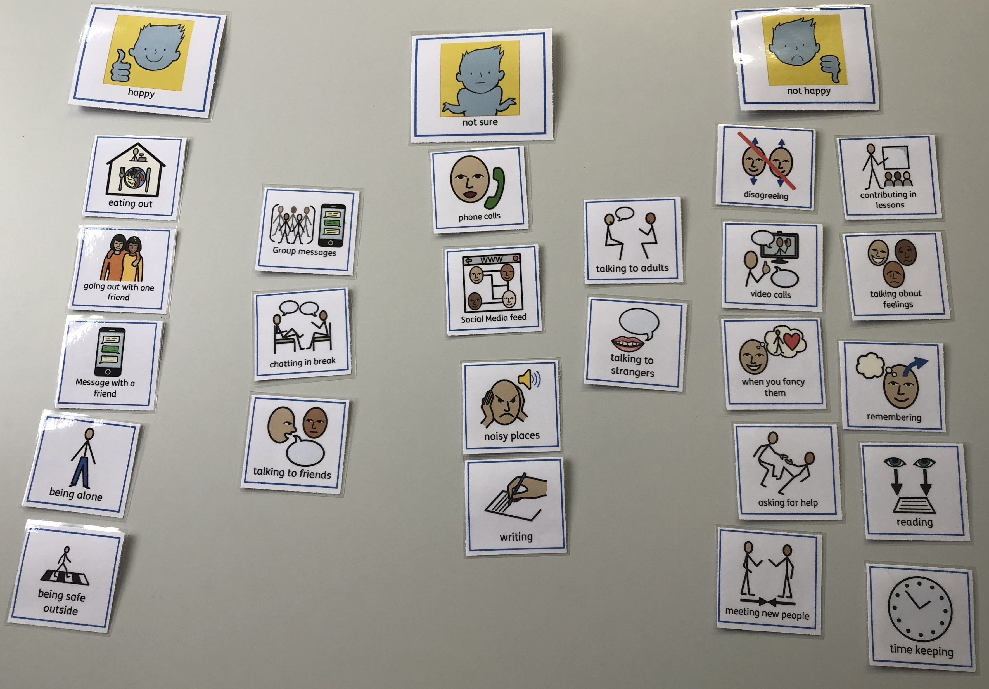
An Example (Year 7 student)

Slide 19
Other strategies
Try to reduce demands on other skill areas to give them the headspace to use their communication skills
Use other non-verbal, easy activities to diffuse the intensity of the situation
Be repetitive each session to avoid surprises
Ensure you tell them your expectations and motives for this session and moving forwards
Give them an element of control, even if that is picking the order of activities, or the game.

Slide 20
References
Fuhrman & Zimmerman, 2011. Pediatric Critical Care (4th Edition). London: Elsevier
Bordin, 1979. The generalizability of the psychoanalytic concept of the working alliance. Psychotherapy: Theory, Research and Practice, 16, p252-260
University of New England, 2018. Nine Ways Teachers Can Help Young Students Overcome Shyness. https://blog.une.edu.au/usingpsychology/2018/09/01/nine-ways-teachers-can-help-young-students-overcome-shyness/
Bloom & Lahey, 1978. Language Development and Language Disorder. New York: Wiley
Johnson & Wintgens (2001). The Selective Mutism Resource Manual. Milton Keynes, UK: Speechmark
Keen, Fonseca & Wintgens (2008). Selective mutism: a consensus based care pathway of good practice. Archives of Disease in Childhood, 93(10), 838-844
MHFA (2007). Youth Mental Health First Aid Manual. London, UK: MHFA

