Slide 1
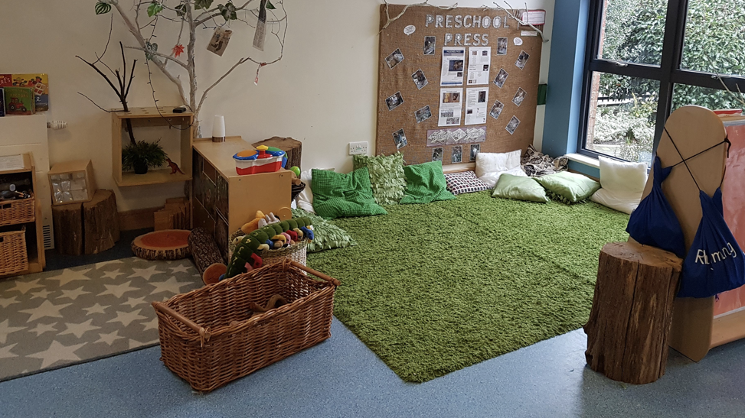
Communication Friendly Environments

Slide 2
Better Communication Research Programme (BCRP)
Language Learning Environment
(The physical environment and learning context)
Language Learning Opportunities
(Structured Opportunities to support language development)
Language Learning Interactions
(The ways in which adults talk to children)
Read the full reports here
Notes:
BCRP following Bercow Report.
Identified 3 elements as important in developing SLC skills.
Not equally important. Physical environment is the area where most improvements have been made.

Slide 3
What is a communication-friendly environment?
A space that encourages and supports language development, where communication is made as easy, effective and enjoyable as possible and barriers to communication are removed.
A thoughtfully designed learning area which acknowledges that children communicate in a variety of ways, visually as well as verbally.
The physical space and how a sense of belonging is created.

Slide 4
What features are important?
BCRP Communication Supporting Classroom Observation Tool
Organisation of space (open spaces and clearly defined learning areas)
Noise
Light
Labelling
Role Play
Notes:
Creating a language rich environment
Importance of role play
Inside and outside spaces

Slide 5
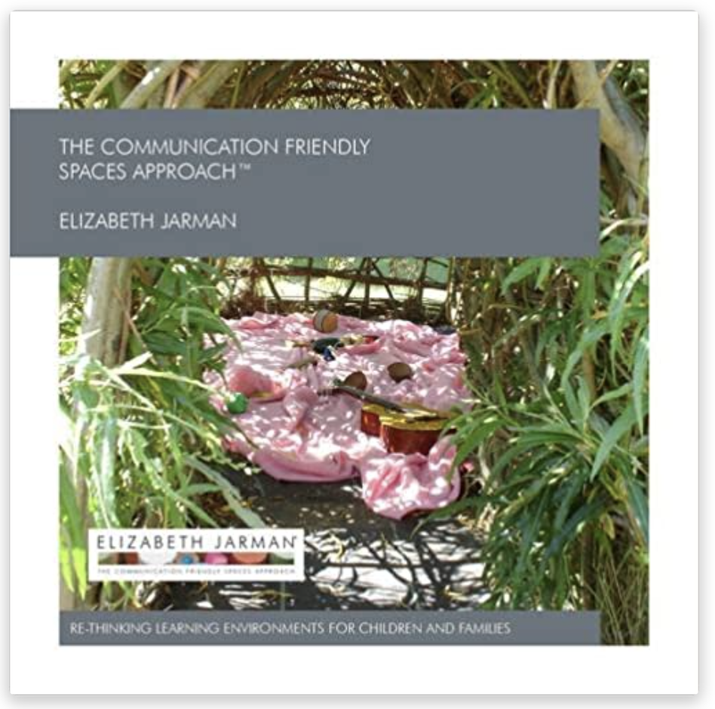
Communication Friendly spaces Approach Elizabeth Jarman
“We need to challenge the historical stereotypes that often exist around the way that learning environments are set up for children, blending new understanding of learning styles, how children really learn and their preferred contexts so that our environments become responsive and dynamic.” Elizabeth Jarman
Key Elements to the approach
Use of space
Storage and resource management
Effects of noise
Use of colour
Impact of light

Slide 6
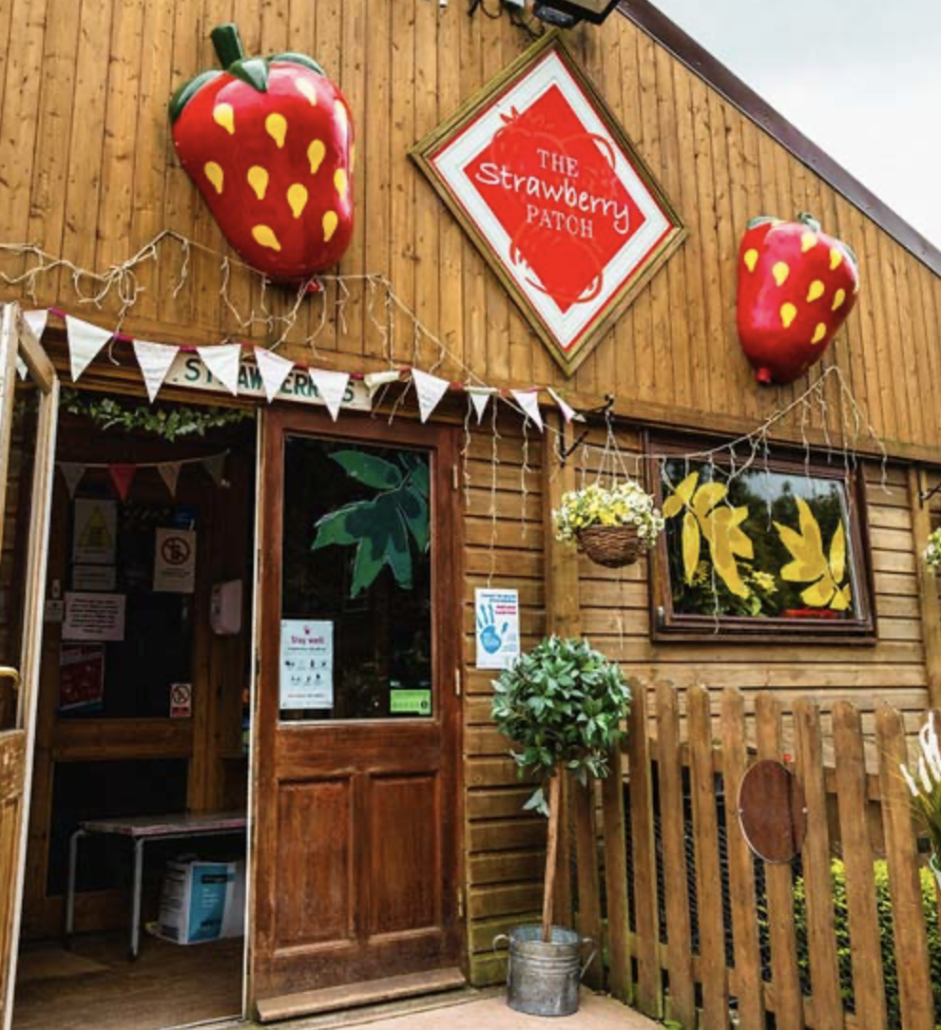
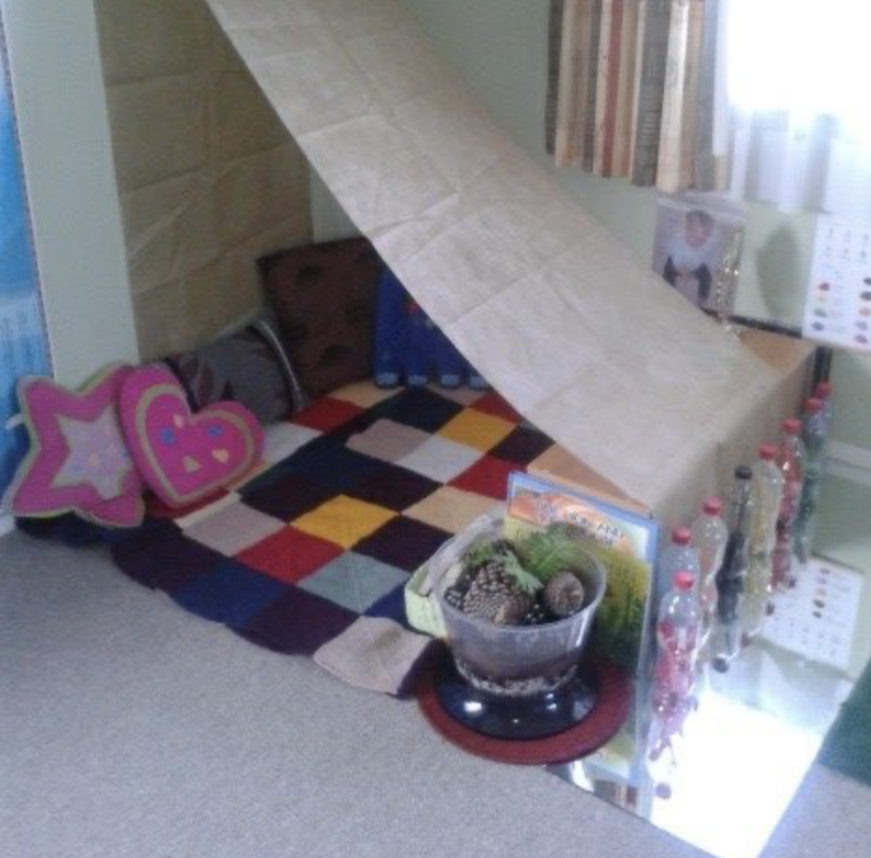
Use of SPace
A welcoming approach to the setting
Small spaces for privacy
Need for softness

Slide 7
Noise
Bronzaft and McCarthy found that children on the quieter side of a school next to an elevated railway had reading scores higher than children on the side exposed to the train noise.
Think about:
Positioning of activities
Using soft furnishings to absorb noise
How can the impact of external noise be minimised?

Slide 8
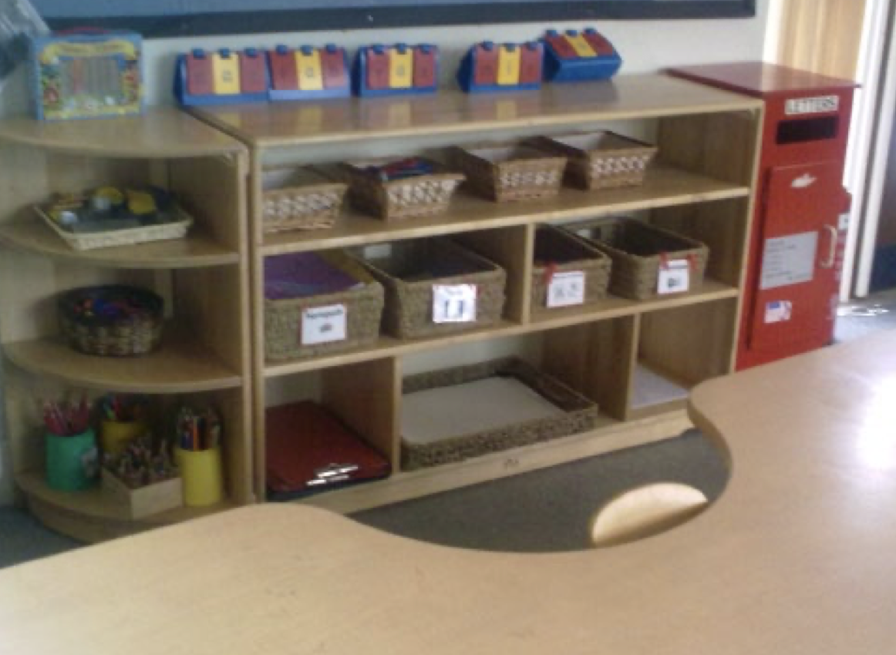
Storage
Clutter
Organise storage
Choice of resources – natural materials
Displays

Slide 9
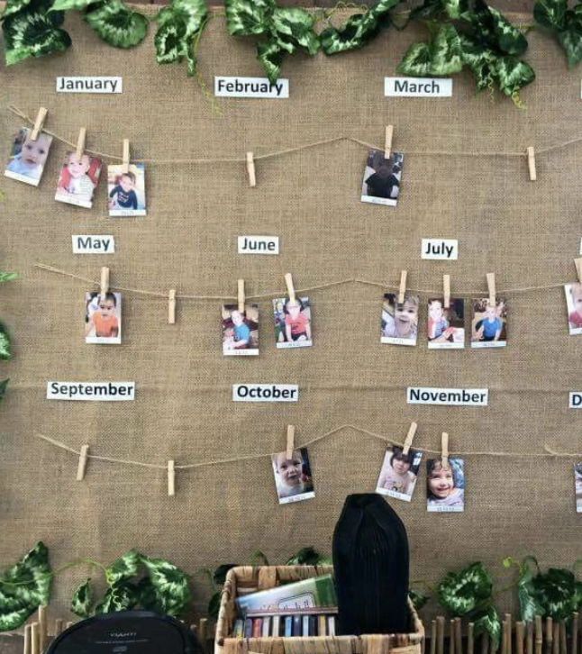
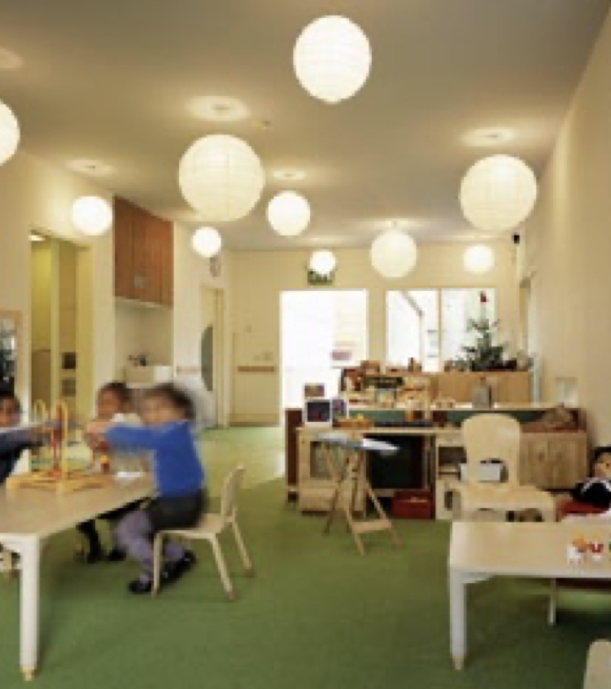
Use of Colour
More thoughtful use of colour can enhance learning.
Primary colours can provoke reactions and be visually distracting.
Becoming too ‘neutral’ can make the setting unwelcoming

Slide 10
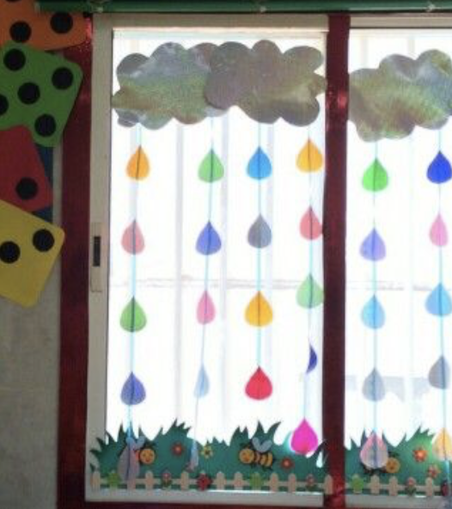
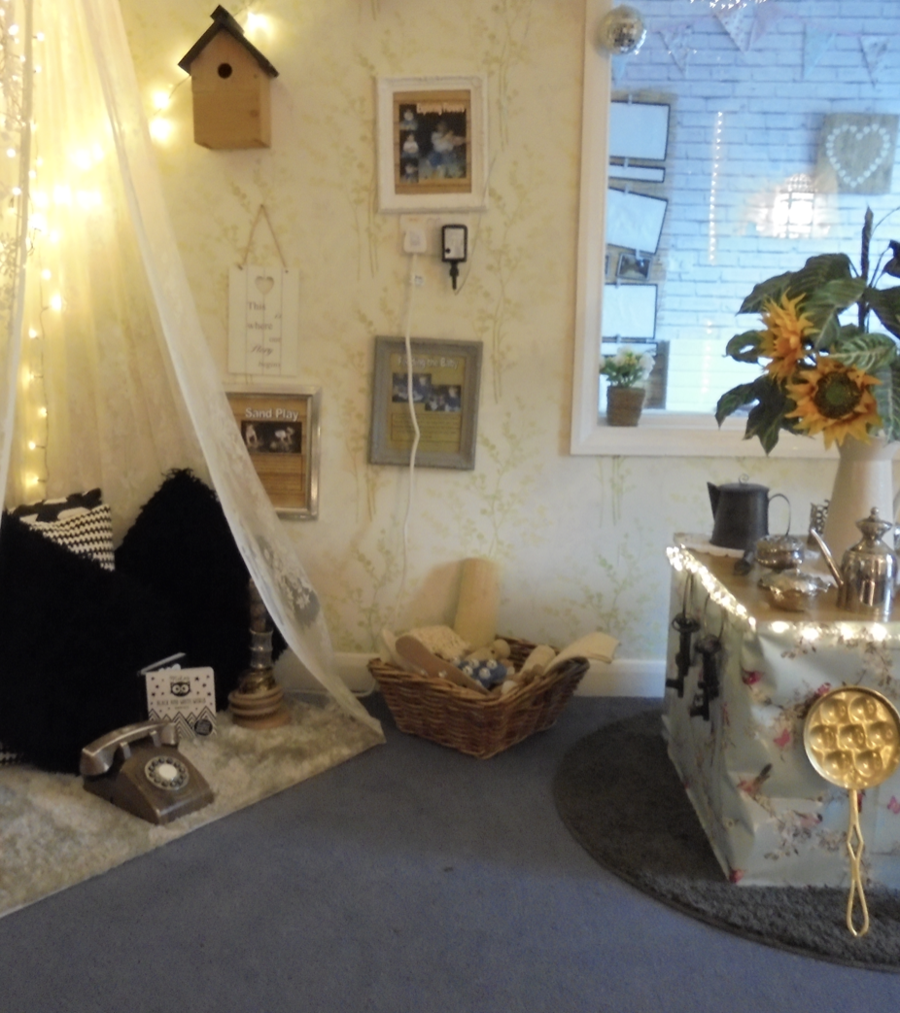
Light
Maximise natural light
Use lighting to use create mood and atmosphere

Slide 11
Things to think about
Look around you. If your setting doesn't make you feel motivated, then it's time to make some positive changes!
When was the last time you critically observed your learning environment?
From a child's point of view, see what the space looks, feels and sounds like.
Elizabeth Jarman, Nursery World 2007

Slide 12
How do we know our environment is communication-friendly?
Observations
Audits
Communication Supporting Observation Tool
Communication Friendly Spaces Audit
ICAN checklists
School’s own audit tools

Slide 13
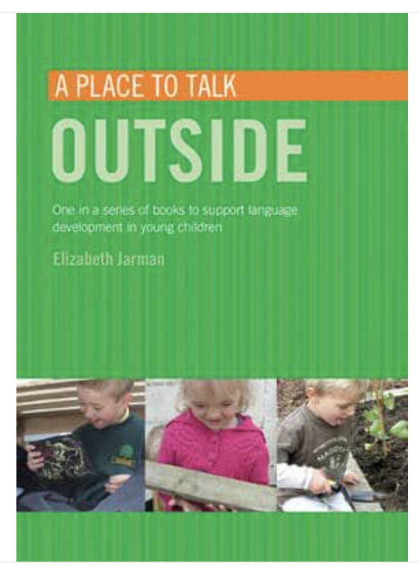
Where to go for further information
https://elizabethjarman.com

Slide 14
Would anyone like to share their own ideas?

