Slide 1
Communication
and Behaviour
in the Early Years

Slide 2
Session outline
This session will explore the link between communication difficulties and behaviour in Early Years children.
It will offer ideas and approaches for staff to support children who may have difficulty communicating their needs and who may have difficult behaviours as an outcome of this.
The strategies suggested are designed to add to and compliment existing effective practice.
As an outcome; practitioners will have more tools to work with for both a proactive and responsive approach to support these children.

Slide 3
Structure of the session
The importance of communication development.
What can be the impact of communication difficulties for children?
Structuring approaches to support these children – being proactive and responsive.

Slide 4
Setting the scene

Slide 5
Communication development
Communication is fundamental to children's development; children need to be able to understand and be understood. Communication is the foundation of relationships and is essential for learning, play and social interaction.
Communication development for young children includes gaining the skills to understand and to express thoughts, feelings, and information.
Speech, language and communication skills are vital for all children. Without these skills they will not reach their full potential.
1 in 10 children have speech, language and communication needs.

Slide 6
Communication impacts on all areas of life
On education:
Poor language predicts poor literacy skills and, without the right help, between 50% and 90% of children with persistent communication needs go on to have reading difficulties. Vocabulary at age 5 is a very strong predictor of the qualifications achieved at school leaving age and beyond.
On employment:
Employers now rate communication skills as their highest priority, above qualifications, with 47% of employers in England reporting difficulty in finding employees with an appropriate level of oral communication skills.
On health:
Poor communication is a risk factor for mental health.

Slide 7
The relationship between SLCN and behaviour
The frustration of not being able to get messages across can lead to outbursts which can be expressed as difficult or even dangerous behaviours.
An inability to pick up on adult’s cues, for example to finish an activity and tidy up, may lead to feelings of anger because their activity needs to end. Being cross can escalate into unwanted behaviours. A failure to respond to instructions such as these, may lead adults to believe this is non-compliance behaviour.
Children who cannot make themselves understood to their peers may suffer relative isolation as their peers become frustrated with not understanding what they are trying to communicate.
Children who have difficulty in making themselves understood may become less confident, anxious, have feelings of inadequacy. The child’s emotions may be hijacked by a stress response, ‘flight, fight, freeze’. This inevitably impacts behaviour.

Slide 8
Identifying children with communication difficulties
Children who have difficulty communicating:
Might be struggling with settling in, joining in with others, understanding routines and instructions or expressing themselves
Aren’t where you would expect them to be when you look at expected development for their age
Aren’t reaching their early learning goals for communication and language and/or personal, social and emotional development.

Slide 9
What do we know?
What do we need to know?

Slide 10
Begin to analyse by identifying successes
The children who have been identified as still developing the communication skills necessary to meet expected goals, need to be ‘tracked’ to find out when and where they are more successful.
This gives an indication of the contexts which support them to communicate more effectively (even just a little bit better).
You can then look to:
Analyse what was happening that supported the child to have success communicating
Plan to replicate this context to provide communication development opportunities for the child across other aspects of their day
Recognise the successes with the child/peers and use explicit praise to help build a vocabulary of success.

Slide 11
Looking for patterns
It is important to recognise when the behaviours which are linked to communication difficulties are happening and when they are not happening.
This analysis paves the way for thinking about the context in which the behavior happens (or doesn’t happen).
Think:
Can the behaviour be changed/maintained/repeated by changing/replicating the context?
How do I support/teach the child to cope when their communication difficulty leads to the behaviours which are difficult?
How do I let the child know when their communication has been effective and their behaviour has been positive?

Slide 12
Behaviour tracking
Dangerous behaviour
Difficult behaviour
Frustration
Difficulty communicating
Less difficulty communicating
Context
Notes:
De escalation is simply the task of being aware of the experiences and feelings of the individual in order to intervene to either change the experience or change the feelings generated by the experience.
The top line shows a service user peaking into crisis twice within a timescale.
The lower line represents exactly the same increases and decreases in anxiety but by how simply lowering the starting anxiety or by lowering anxiety at any presented opportunity we can avoid the peaks into crisis.

Slide 13
Behaviour tracking – the OK grid
VERY OK When is the child’s behaviour ‘very OK’? What are the expectations at this time around communication? How do they communicate at these times? How do they manage frustration at these times? What facilitates/supports this effective communication at these times? | AVERAGE OK
NOT VERY OK | DEFINITELY NOT OK When is the child’s behaviour ‘definitely not OK’? What are the expectations at these times around communication? How do they communicate at these times? What do they do when they are frustrated at these times? How is communication facilitated/supported at these times?
Notes:
The OK grid is extremely versatile. Use it to record the ‘general behaviour’ of a class, group. The ‘not very OK’ names are the ones to focus on. You can take one or two of these and then use the OK grid to track their behaviour across a period of time (a single lesson/activity to a day, a week, you decide). Note the very OK behaviours, what are they and the context and the same across each quadrant. This gives a good indication of successes and can help set the scene for a positive conversation re behaviours, form part of the analysis and planning process etc.

Slide 14
Negative behaviour
Positive behaviour
Snatching toys
Running away
Biting & scratching
Refusal
Hiding Crying
Communicate needs/feelings
Playing with peers
Being kind to others
Following instructions
Able to self-regulate
Negative feelings
Positive feelings
Frustrated Confused Ignored
Under threat Sad
Lonely Scared
Included Proud Welcomed Safe
Confident Understood
Negative experiences
Positive experiences
Not being understood Too rushed
Not being able to communicate my feelings
Inconsistent practice Being blamed
Time Consistent approaches
Adults listen and are patient
Access to a range of communication aids
‘Now and next’ board Slowed down

Slide 15
Responding

Slide 16
Supporting communication
The child’s actual behaviour, both positive and negative, is one way of them communicating needs, feelings, thoughts etc.
There is a myriad of resources which can help adults and children communicate visually.
What is being used with your children? Is this being used consistently? Does it work?

Slide 17
Creating a climate for positive communication
Take some time to consider how your physical environment (and social and emotional environment) provides the ‘climate’ which maximises the potential for the children who have communication difficulties to be able to communicate successfully.
Positive and enabling relationships with adults and peers
Consistent practice
Shared strategies (embedded in plans)
A language rich environment
Established routines and responses (including use of scripts)
Safe places
Use of communication aids
Differentiated planning
Acknowledgement of successes
Support from other professionals

Slide 18
First and foremost:
Building positive and trusting relationships
The importance of establishing positive relationships with children is fundamental to their wellbeing and their capacity to flourish. A positive relationship provides an environment within which children feel safe, valued, supported, and where they can get it ’wrong’.
Think of Maslow’s hierarchy of needs. Positive relationships underpin this from bottom to top.
To consider:
How do we build relationships? What aspects of a relationship are particularly important for a child with SLCN?
How do we support SLCN children to build positive relationships with their peers and vice-versa?
Particularly important where isolation from/by peers may be a factor.

Slide 19
Decide on and plan your focus to support the child
Deciding where the focus for support needs to be will also support the child to have a focus.
Use your tracking/analysis information to inform priorities for action. Will this be:
‘Quick wins’ to build a sense of competency and confidence (in adults as well as the child)
Focus on something more complex and ‘long term’
A mix of these?
Use your tracking/analysis information to inform planning.
Your planning will set out differentiated approaches to develop effective communication.
The ‘Norfolk Steps’ planning template may be useful here.

Slide 20
POSITIVE COMMUNICATION AND BEHAVIOUR PLAN
Name: | DoB: | Plan date: | Version of plan: Review date:
Focus of this plan:
Brief description of presenting communication difficulties and resultant difficult / dangerous behaviours: |  | Positive behaviours/communication skills we wish to see / have:
Differentiated measures to promote / support positive communication and behaviours:

Slide 21
 | Positive communication/behaviours you will see: | What you will say / do:
 | Difficult communication/behaviours you will see: | What you will say / do:
 | Dangerous behaviours you will see: | What you will say / do:
Post incident recovery & debrief measures:
Signature of plan co-ordinator: Date: Signature of parent / carer: Date: Signature of child / young person / service user (if appropriate): Date:

Slide 22
Supporting children to manage their behaviour
A range of strategies can be used effectively to support children with communication difficulties to manage their behaviour:
Visual and verbal – support the child; ‘when I feel like this, I can do these things’ to help me regulate my own behaviour (and to tell adults how they feel)
Provide ‘safe’ places where children can go to or be taken to
Have restorative activities which support children to understand that their behaviour impacts on others
Use positive phrases, limited choices, scripts
Use social stories.
For these approaches to be most successful, the child’s communication needs must also be addressed.

Slide 23
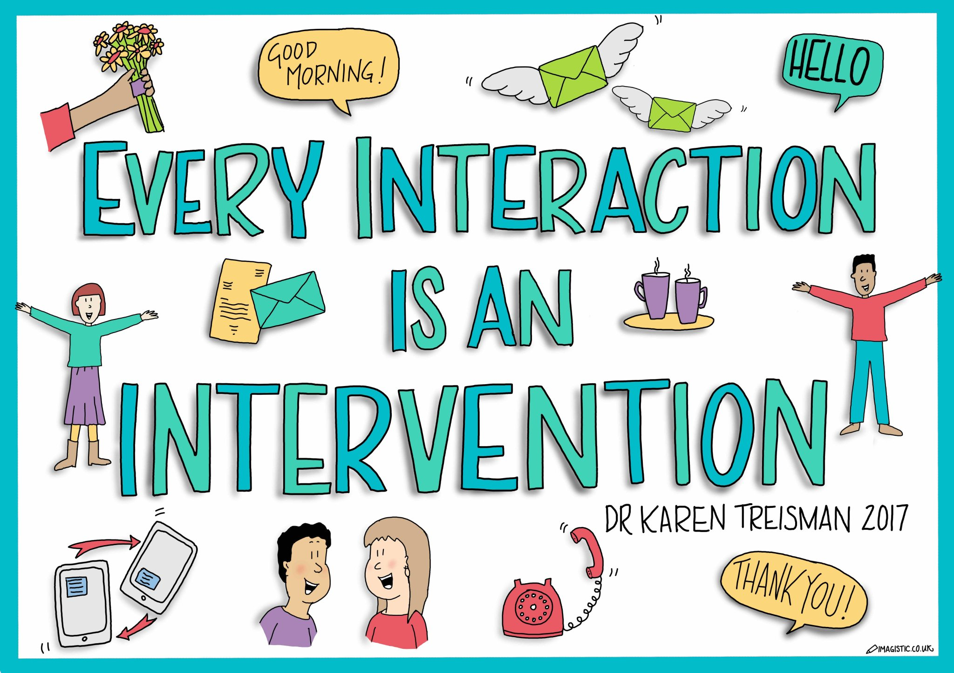
Remember the little things
Often it is the little things done consistently that make the biggest difference.
Remember to:
Meet and greet and smile
Get down to their level
Make eye contact
Give them time to ‘tell’ you what they need and how they feel
Be very patient
notice their little successes/triumphs and share with colleagues and parents
‘Touch base’ regularly
Initiate opportunities for facilitated peer interactions.

Slide 24
Summing up
Analyse, understand, explain and interpret the communication needs and the behaviour.
Provide positive experiences through differentiated planning.
Provide a language rich environment.
Build positive relationships.
Be consistent.
Be responsive.
Review regularly.

