Slide 1
The North Norwich Communication Hub
A NOA Communication Hub
Notes:
SA Introductions
One of the 4 Communication Hubs established by the NOA to create a sustainable legacy from the CC project.

Slide 2
What is a Communication Hub?
The Centre of a Communication Champion's Network
School Partnerships; families and agencies
In-school good practice and prioritisation of SLC development
One of 4 Communication Hubs set up by the NOA
A setting with an active commitment to improving the speech, language and communication development for all children.
A place where partnerships with families and services are grown and developed.
The centre of a professional community formed to share good practice, facilitate access to specialist expertise and support ongoing training.
Notes:
SA

Slide 3
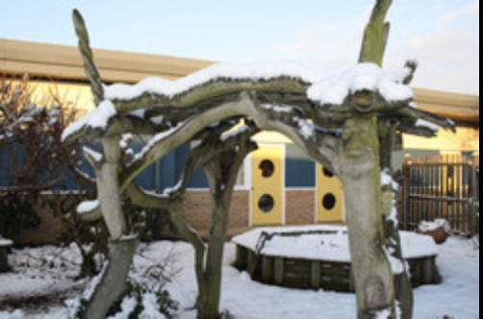
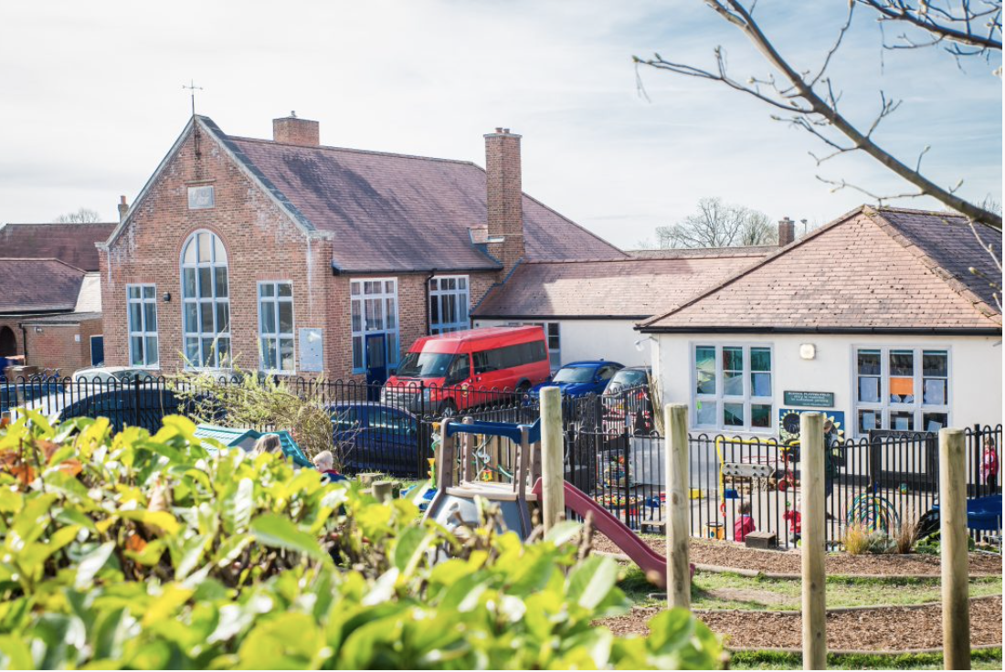
Our Partnership Schools
Mile Cross Primary School
Catton Grove Primary School
Lionwood Infant & Nursery School
Notes:
SA
The North Norwich Communication Hub is a partnership between MCP, CGPS and LIANS.
Staff from each school attended the initial Communication Champion training together and then the leadership training.
Within the same cluster, it made sense to pool our expertise and work together on the Hub.
Can be logistically difficult working across schools, but learn from each other’s practice and can provide professional challenge to each other.

Slide 4
“Children who find communication hard find life hard”
Notes:
SA
This is what has motivated us!
Huge body of research on the impact of SLCN on all areas – learning, social and emotional development, employability, future life chances.

Slide 5
Notes:
SA
By intervening early, we can improve outcomes for all children and work towards no child being left behind.

Slide 6
Within our own schools
Aspiring to become centres of excellence showcasing good practice in Speech, Language and Communication
Cascaded training for all staff
Audits of practice:
Communication Friendly Environments Communication-Supporting Teaching
Interventions
Assessment & monitoring
Partnerships
Family Learning
Reflective practice and ongoing improvement
Notes:
EM
One part of being a Communication Hub is the focus on SLC development within our own school, to improve outcomes for our catchment families.
Context of deprivation shown by Hart and Risley to impact negatively on SLC development.
Aspire to become a centre of excellence in order to support other schools and settings.
As Hub leads, we are not ‘experts’, but are committed to improvement.

Slide 7
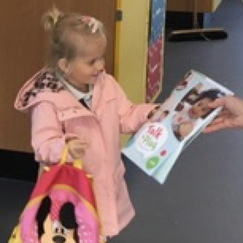
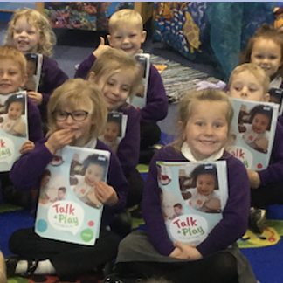
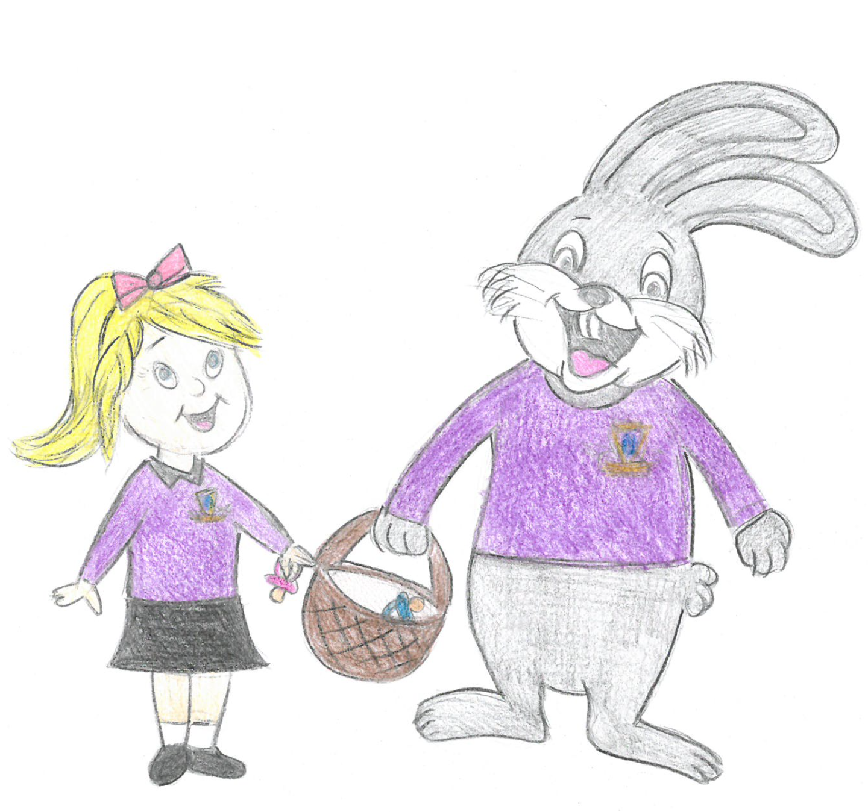
Making slime at a ‘Chatter Matters’ Communication Café. Messy Play isn’t just good in the Early Years.
‘Talk & Play’ Packs for all of our Early Years Children.
Supporting Home Learning
Give your dummy to the Mile Cross Bunny.
A campaign to reduce dummy use in nursery.
Working in partnership with parents to develop speech and language in the home.
Notes:
EM
Huge importance of learning in the home, particularly in the pre-school years.
Working with parents, working with other services and taking advantage of local opportunities, such as Talk and Play packs, working with UEA speech and language students.
Being a Hub School has provided an additional impetus for this.

Slide 8
Across the network
Half-termly network meetings (currently via Teams)
Chaired by Hub Leads
Attended by trained Communication Champions from local schools and settings/any practitioner with an interest in SLC in the Early Years and beyond/local services and agencies
CPD element
News and updates
Sharing good practice and current research
Access to training
Notes:
EM
Hub is the centre of a network comprised of practitioners from schools and settings, predominantly early years but anyone with an interest in SLC.
CPD has included working with parents/supporting families with EAL/language and behaviour.
Developing a professional community working across settings and across agencies.

Slide 9
Partnerships
Communication Hubs
Educational psychology
Speech and language services
Nursery practitioners in settings
School Staff
Family Learning
Library Services
Just One Norfolk Health Service
Early Years Advisors
Specialist Resource Bases
“From silos to networks”
Notes:
The Bercow Report highlighted the problems caused by ‘silo’ working. We hope to develop sustainable partnerships within our network to build common understanding and work more efficiently.

Slide 10
Beyond our network
North Norwich Communication Hub
Peapod Pre-school Communication Hub
Lakenham Primary Communication Hub
0-2 Partnership Hub
Working across (and beyond) Norwich to support all children from 0-11
Notes:
Our hub is one of the 4 NOA Communication Hubs. Hub leads meet half-termly to share plans and to plan collectively.
Recent training offer to all member schools/settings (not just those who attend meetings)

Slide 11
Setting up a network
Things to think about
Who’s in the network – CCs from training, emails to local schools and nurseries, word of mouth
What to do in the meetings – questionnaires to network members to inform planning
Speakers – local expertise and CC’s skills
Organisation- distribution list, agenda, invitations, minutes ….
Information sharing – updates between meetings
Notes:
Time commitment, but gains in terms of development of own school’s skills and confidence.
If thinking about setting up own network, ensure that whoever is leading it is actively wants this responsibility and is given the time and support to do this!
Need for persistence- turn out for meetings can be disappointing, resilience – technology fails and set-backs in organising training etc.
Making a difference to practice in schools and settings.

Slide 12
How to find out more ….
Visit our website
https://www.thecommunicationhub.net
Follow us on Twitter @norwich_hub

Slide 13
How to join a network
Anyone is welcome to join one of the NOA Communication Hub networks.
Contact the NNCH through the links on our website or at senco@milecrossprimary.Norfolk.sch.uk
Our next meeting is on 21st September 4-6pm (details TBC)
Or email Project Manager, Ashley Cater ashley.cater@norfolk.gov.uk

Slide 14
Any Questions?

Slide 15
Thank you for your interest in our Communication Hub.

